Slide 1
GPS NMEA Protocol Parse
Wentao Bi
ASC, Nexteer
03/17/2018

Slide 2
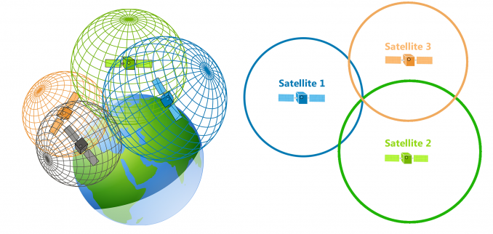
Introduction
GPS Theory in Math

Slide 3
NMEA Standard (Brief)
Define electrical signal requirements, data transmission protocol and time, and specific sentence formats for a 4800-baud serial data bus.
This data is in printable ASCII form and may include information such as position, speed, depth, frequency allocation, etc.
My task is to parse message/ data structure and extract useful information like Lan/ Lon, time. Finally send it to CAN message.

Slide 4
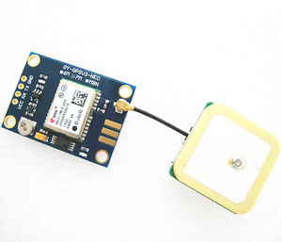
GPS Receiver – NEO 7M
Product main description
Supply: 1.65V – 3.6V
Position accuracy: 2.5m
Velocity accuracy: 0.1m/s
Heading accuracy: 0.5 degrees
Interface: UART (Baud rate: 9600, 8 data bits, 1 stop bit,
no parity and flow control)
Protocol: NMEA, UBX binary

Slide 5
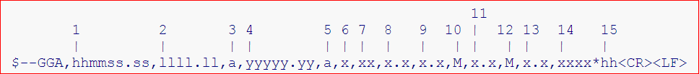
Message Structure
Talker ID – Sentence ID (34 x 76)
E.g.
GP-GGA
This is one of the sentences commonly emitted by GPS units.
Time, Position and fix related data for a GPS receiver.

Slide 6
Message Received
$GPGLL,4224.78155,N,08308.28698,W,032132.00,A,A*7A
$GPRMC,032133.00,A,4224.78159,N,08308.28692,W,0.356,,090318,,,A*67
$GPVTG,,T,,M,0.356,N,0.659,K,A*29
$GPGGA,032133.00,4224.78159,N,08308.28692,W,1,07,1.07,205.8,M,34.8,M,,*64
$GPGSA,A,3,28,17,19,06,22,02,12,,,,,,1.68,1.07,1.30*0A
$GPGSV,3,1,09,02,35,239,15,03,22,047,08,06,74,245,20,12,23,316,20*72

Slide 7
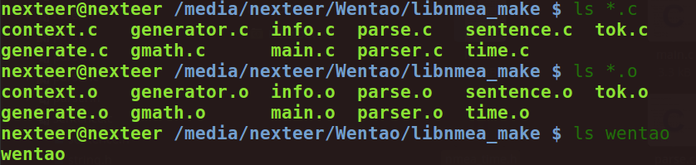
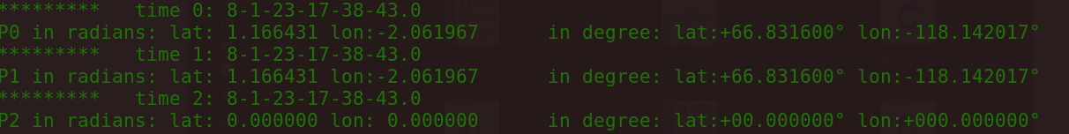
Parser code
Make process
Output data

Slide 8
Thanks!
Question?

